Slide 1
The Impact of COVID-19 on Last-mile Latency
Romain Fontugne¹, Anant Shah², Kenjiro Cho¹
¹IIJ Research Lab
²Verizon Digital Media Services

Slide 2
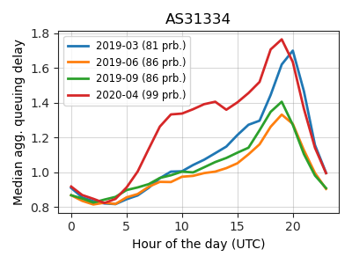
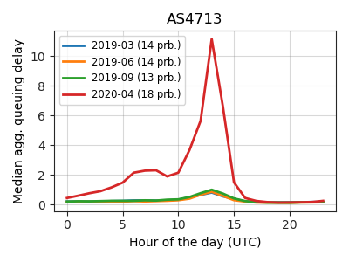
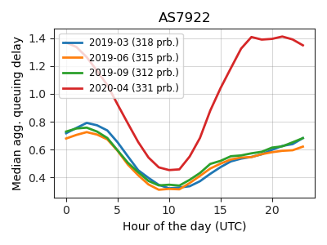
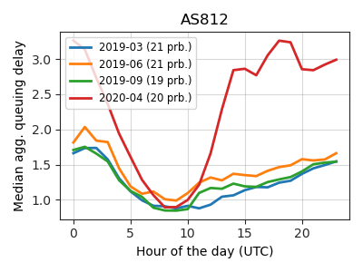
Example Last mile latency (RIPE Atlas)
Small delay Increase during
daytime
Severe
last-mile
congestion
Higher last-mile delays during lockdown

Slide 3
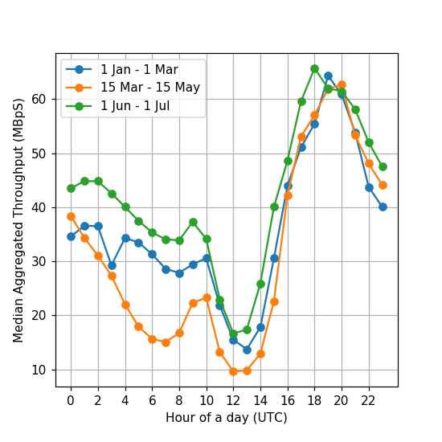
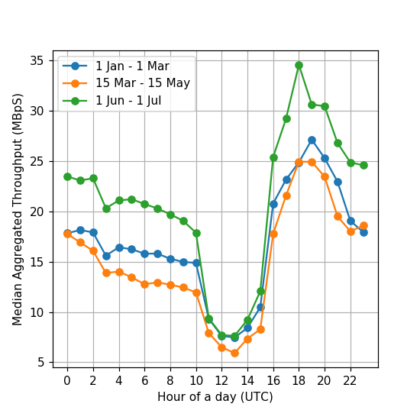
Throughput in Japan (MLab ndt data)
NTT OCN
Softbank
Faster Internet
after
COVID!
Two drops per day during stay-at-home (up to 50% decrease during daytime)

Slide 4
Summary
Overall 55% more ASN with higher last-mile latencies during COVID-19 (RIPE Atlas)
In Japan:
Clear throughput drop and increased last-mile latency during stay-at-home measures
Last-mile congestion on legacy network (PPPoE)
Mobile network unaffected (throughput)
See also:
https://last-mile-congestion.github.io/ (paper and more results)
https://ihr.iijlab.net/ihr/en-us/covid19 (inter-domain latency)

